Slide 1
Streaming Platform Analytics: Engagement, Retention, Conversion & Churn Analysis
Name: Anis Ahmed
Role: Data Analyst Project
Tools: Python | SQL | Pandas

Slide 2
Business Problem & Objective
Business Problem:
The platform is facing challenges in converting active users into paying subscribers and retaining users over time. There is limited visibility into behavioral patterns leading to churn
Objective:
Analyze user behavior and engagement patterns to uncover drivers of retention, conversion, and churn, and generate actionable insights to improve user retention and monetization

Slide 3
Dataset Overview
Users: 10,000
Events: ~134,000
Tables:
Users
Events
Sessions
Subscriptions
User Activity
Key Features:
User Activity tracking
Subscription Lifecycle
Engagement signals (viewing, search, etc.)

Slide 4
Data Preparation
Handling missing values and inconsistencies
Created derived Tables:
Sessions(user interaction level)
Subscriptions (lifecycle tracking)
User Activity (daily behavior)
Defined engagement events:
app_open, search, play_content, watchlist

Slide 5
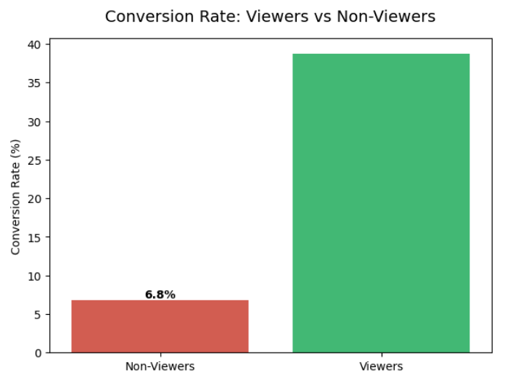
Conversion Insight
Key Finding:
Users who consume content are ~5-6x more likely to convert
Interpretation:
Content consumption is the strongest driver of monetization

Slide 6
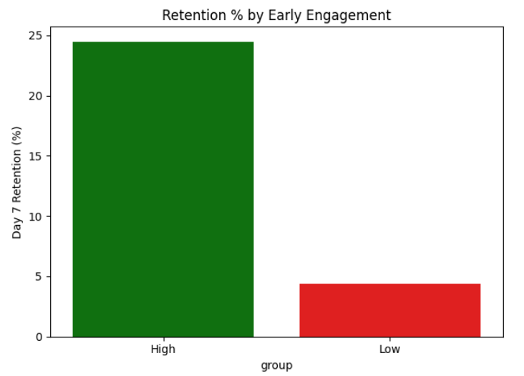
Retention Insight
Key Finding:
High Activity users are ~5x more likely to return
Interpretation:
Early and frequent usage builds user habit and retention

Slide 7
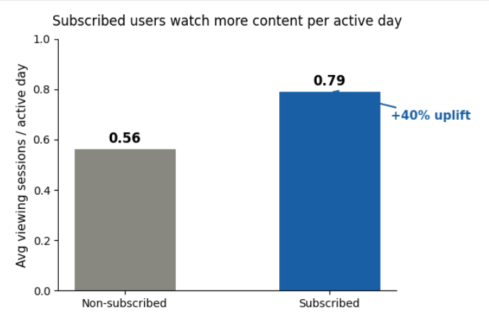
Engagement vs Subscription
Key Finding:
Subscribed users consume ~40% more content per active day
Interpretation:
Paying users derive more value from the platform
Engagement and monetization are strongly linked

Slide 8
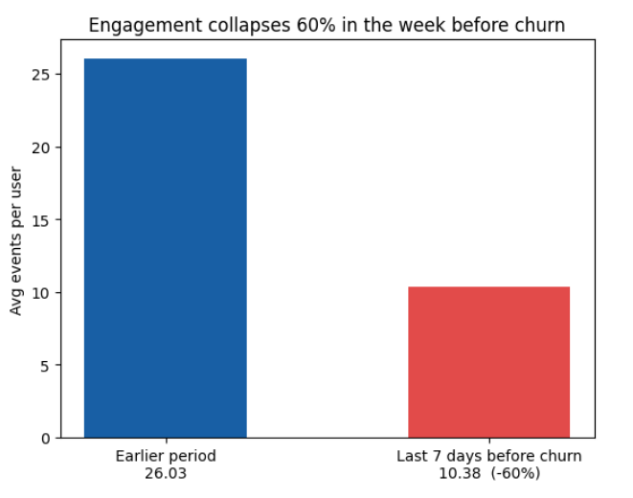
Churn Behavior
Key Finding:
Engagement drops by ~60% in the 7 days before churn
Interpretation:
Churn is preceded by behavioral decline
Strong signal for churn prediction

Slide 9
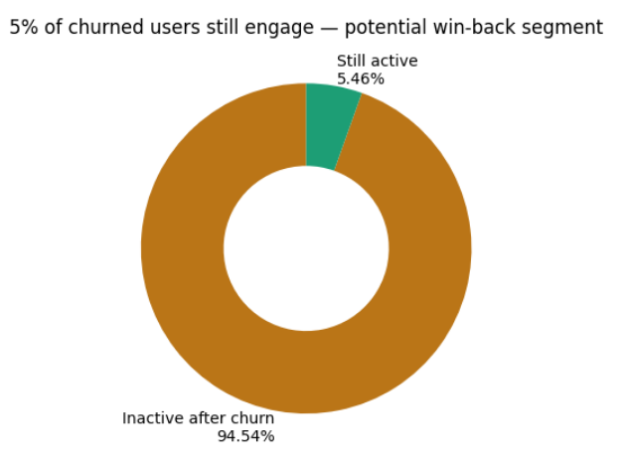
Post-Churn Behavior
Key Finding:
Only ~5% users remain active after churn
Interpretation:
Churn is a terminal event
Post-churn recovery opportunities are limited

Slide 10
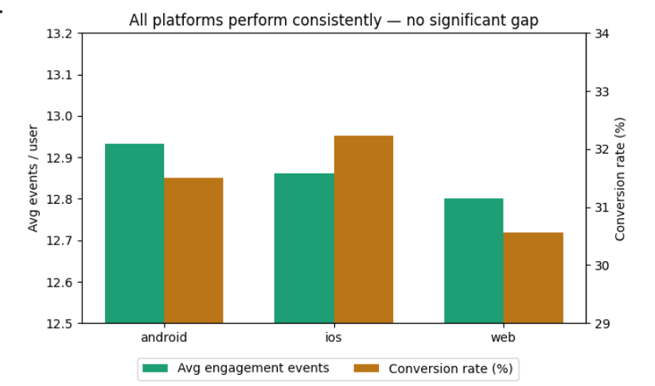
Platform Analysis
Key Finding:
No significant difference across Android, iOS, and Web
Interpretation:
Platform is NOT a key driver
Focus should be on user behavior, not device

Slide 11
Key Insights Summary
Engagement drives conversion and retention
Declining activity is a strong indicator of churn
Most churned users do not return
Large portion of active users are not monetized

Slide 12
Business Recommendations
Early Churn Detection:
Monitor drop in engagement
Trigger alerts for declining activity
Improve Content Discovery
Increase visibility of relevant content
Encourage early engagement
Convert Active Users
Target active but non-subscribed users
Personalized offers & nudges
Focus on Engagement
Churn is a terminal event Increase content consumption
Improve onboarding experience

